Slide 1
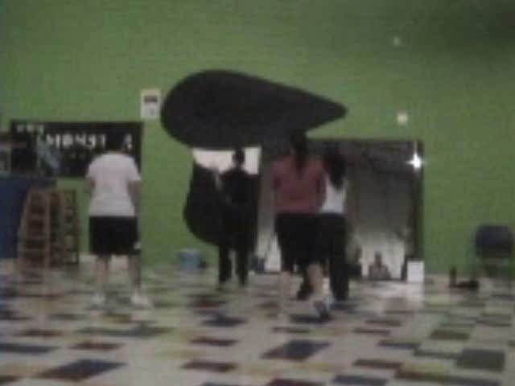
Zumba Dancing

