Slide 2
Weeding Through The Issues of Legalized Marijuana in California – A Workplace Analysis
CVSS Members’ Forum
March 8, 2017

Slide 3
Disclaimer
The materials presented in this outline are for seminars and training exercises conducted by Fishman, Larsen & Callister (“FLC”). No other or entity may use or reproduce this document, in full or part, without the express written authorization of FLC.
The materials do not constitute an integrated text or an exhaustive analysis of the law or the subject matter. The materials are not intended to be, and should not be construed as constituting legal advice with regard to a specific case, set of facts, or transaction, or an opinion or advice of FLC.

Slide 4
What is Proposition 64?
It creates a “system to legalize, control and regulate the cultivation, processing, manufacture, distribution, testing, and sale of nonmedical marijuana for use by adults 21 years and older, and to tax the commercial growth and retail sale of marijuana.”

Slide 5
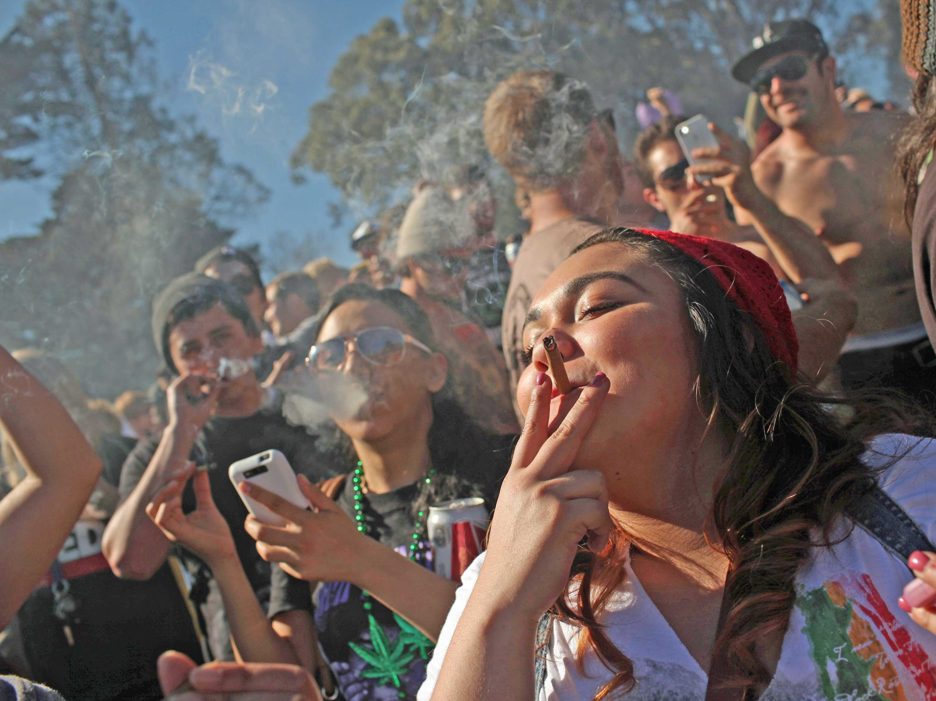
What We Will Not Cover
The wisdom of using marijuana

Slide 6
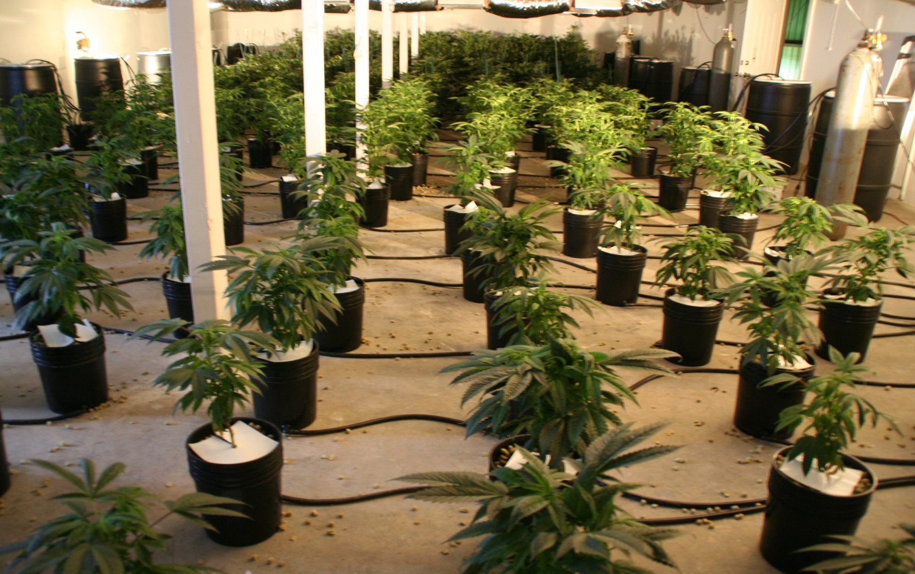
What We Will Not Cover
Cultivation Practices

Slide 7
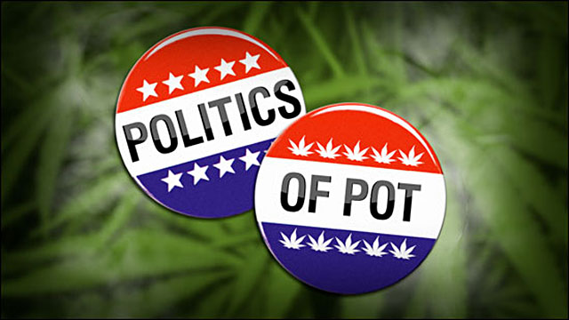
What We Will Not Cover

Slide 8
What We Will Cover
What impact, if any, does Prop 64 have on your workplace?
What is the law?
What can I do to maintain a safe workplace?

Slide 9
Prop 64 – Personal Use
Possess, process, transport, purchase, obtain, give away 28.5 grams of marijuana;
Possess, process, transport, purchase, obtain, give away 8 grams of concentrated cannabis;
Possess, cultivate, harvest, dry, process six marijuana plants;
Smoke or ingest marijuana and products;
Possess, process, transport, purchase, obtain, use, manufacture, give away accessories.

Slide 10
Prop 64 – Personal Use
Marijuana: The plant, seeds, resin, compounds, derivatives, mixture or preparation of the plant, seeds or resin.

Slide 11
Prop 64 – Personal Use
Marijuana Products: Marijuana that has undergone a process whereby the plant has been transformed into a concentrate.

Slide 12
Prop 64 – Personal Use
Marijuana Accessories: Equipment, products, materials used or designed for use in planting, propagating, cultivating, growing, harvesting, manufacturing, compounding, converting, producing, processing, preparing, testing, analyzing, packaging, storing, smoking, vaporizing, or containing marijuana, or for ingesting, inhaling or introducing to the body.

Slide 13
Prop 64 – Personal Use
Smoking or ingesting marijuana or marijuana products is prohibited
In public places;
Within 1,000 feet of a school, day care, youth center while children present;
While driving a vehicle, boat, aircraft.

Slide 14
Prop 64 – Personal Use
The law does not restrict the rights and obligations of employers to maintain a drug and alcohol free workplace.

Slide 15
Prop 64 – Personal Use
The law does not require an employer to permit or accommodate the use, consumption, possession, transfer, display, transportation, sale, or growth of marijuana in the workplace.

Slide 16
Prop 64 – Personal Use
The law does not affect the ability of employers to have policies prohibiting the use of marijuana by employees and prospective employees.

Slide 17
Prop 64 – Personal Use
The law does not prevent employers from complying with state or federal law.

Slide 18
Drug-Free Workplace Act
Applicable to federal contractors and grantees.
Drug-free awareness program.
Penalties for drug use, or participation in rehab.
No authorization or requirement for drug testing.

Slide 19
Banning Use, Possession or Sale
Ban the use, possession, sale or transfer of marijuana in the workplace or during working time.
Part of more comprehensive policy including alcohol use, and the illegal use of any substance that can impact workplace safety.
Fire employees for policy violations.

Slide 20
Summary of Prop 64 & Workplace
You can maintain a Drug-Free Workplace.
You can prohibit the growth, use, possession, sale or transfer of marijuana in the workplace or during working time.
You can prohibit working under the influence.
Employees are not protected because they are users.

Slide 21
At-Will Employment
Maintaining at-will employment.
It is a legal presumption.
It is negated by unintentional employer conduct
Handbook provisions
Stray comments
I like to enter into contracts for at-will employment with employees.

Slide 22
At-Will Employment
Understanding at-will employment.
You can fire for any reason;
You can fire for a wrong reason;
You can fire for an arbitrary reason;
But you can’t fire someone who is protected
Civil Rights
Whistleblower
Privacy Rights

Slide 23
Hypothetical: Protected Class
Marv’s behavior has changed. He is slower, less responsive, even lethargic. You ask Marv if he is ok. He says he has chronic back pain that is alleviated only with marijuana. He quickly pulls out his medical marijuana card to prove he is legally consuming.
What can you do? What should you do?

Slide 24
Hypothetical: Protected Class
Is Marv in a protected class? Is he an individual with a disability?
Are you prevented from taking action because of Marv’s bad back? Because of Marv’s disability?

Slide 25
California’s Constitutional Provision
Art. 1, Sec. 1: All people are by nature free and independent and have inalienable rights. Among these are enjoying and defending life and liberty, acquiring, possessing, and protecting property, and pursuing and obtaining happiness and privacy.

Slide 26
California’s Constitutional Provision
What is an unalienable right?
They are not given; therefore, they cannot be taken away. The “Creator” bestows absolute rights. (Thom. Jefferson)
Since they are “absolute” courts and legislatures attempt to circumvent them by describing the limits of inalienable rights.

Slide 27
Privacy – Intrusion into Private Affairs
A reasonable expectation of privacy
An intentional intrusion
Highly offensive to a reasonable person
Causing harm
(California Civil Jury Instructions)

Slide 28
Privacy – Intrusion into Private Affairs
What creates a reasonable expectation of privacy?
The identity of the defendant;
The extent to which other persons had access and could see or hear the complainant;
The means by which the intrusion occurred.

Slide 29
Privacy – Intrusion into Private Affairs
How do I determine if an intrusion is highly offensive to a reasonable person?
The extent of the intrusion;
The person’s motives and goals; and
The setting of the intrusion.

Slide 30
Privacy Rights
Loder v. City of Glendale (1997) 14 Cal.4th 846
Suspicion-based vs. suspicion-less testing.
Applicant vs. existing employee.
Informational and autonomy rights.

Slide 31
Privacy Rights
Informational: Information about you, including substances in your body, or information about your medical condition.
Autonomy: Certain activities we do in private, including urination.

Slide 32
Privacy Rights
Applicants: Employers know very little about applicants. Therefore, an employer’s justification in drug testing is greater for an applicant than an existing employee.
Existing employees: Employers have observed their behavior, and therefore have lower justification for drug testing.

Slide 33
Privacy Rights
Suspicion-based testing: The employer has some level of suspicion for testing for drugs. Suspicion is based on observation.
Suspicion-less testing. Random testing. Justification must be based on the type of work performed – safety sensitive.

Slide 34
Balancing Privacy Rights
Applicant Expectation of Privacy
(Reduce it)
Employer Justification for Intrusion
(Safety)
Minimize the Intrusion
(Training)
(Monitor)

Slide 35
Privacy Rights Hypothetical
I just received a telephone call. My supervisor just told me that an employee came to work smelling heavily of marijuana.
Can I test him/her for drug use?
What type of test is this considered?

Slide 36
Civil Rights
The ADA prohibits the medical examination of a current employee absent
Job-relationship and
Consistent with business necessity
Drug testing is not a medical exam.
Alcohol testing is a medical exam.

Slide 37
Civil Rights
Under the ADA, you can test for the illegal use of substances; however,
No testing for past use
Obtaining a list of medications before testing may be problematic

Slide 38
Civil Rights Hypothetical
I just received a telephone call. My employee was involved in a serious vehicular accident.
Can I test him/her for alcohol use?
What type of test is this considered?

Slide 39
Privacy & Civil Rights Hypothetical
My employee was injured on the job. The company requires drug testing whenever an accident occurs. I sent him/her for testing. He is refusing.
What type of test is this considered?
Can I discipline or fire the employee for refusing to take the tests?

Slide 40
Privacy & Civil Rights Hypothetical
My employee was observed driving erratically. Then he ran into a car stopped for a red light at an intersection. He appeared disoriented when exiting the vehicle.
Can I test the employee for drug and/or alcohol use?
Is there any reason I would not want to test the employee?

Slide 41
New OSHA Rule
29 U.S.C. 1904.35(b)(1)(iv) prohibits an employer from discharging or discriminating against an employee for reporting a work-related injury or illness.
This includes any adverse action that could dissuade a reasonable employee from reporting a work-related injury or illness.

Slide 42
New OSHA Rule
This rule applies to any “blanket post-injury drug testing policies” that deter proper reporting.
Post-accident drug testing must be limited to situations in which:
employee drug use is likely to have contributed to the incident, and
for which the drug test can accurately identify impairment caused by drug use.

Slide 43
Civil Rights Hypothetical
Drug testing is expensive. Therefore, I have decided to test just those applicants who look a little “rough around the edges.”
Is this a smart practice?
Could the practice violate civil rights?

Slide 44
Civil Rights Hypothetical
I have an employee who complains about everything. I have a hunch she uses drugs. I’m going to send her for drug testing.
Is this suspicion-less or suspicion-based testing?
What is the justification for the testing?
Could this violate the employee’s rights?
Could this give rise to a lawsuit for retaliation?

Slide 45
What is Reasonable Suspicion?
Physical characteristics
Paraphernalia
Behaviors

Slide 46
Marijuana Reasonable Suspicion
Appearance: Normal to dilated pupil, slow reaction of pupil to light, nonconvergence, horizontal nystagmus, swollen eyelids, watering.
Behavior: Disoriented, sluggish, fumbling, uncoordinated, etc.
Speech: Slow and slurred
Odors: Marijuana.
Possession: Paraphernalia

Slide 47
Marijuana Reasonable Suspicion
Nystagmus
http://www.bing.com/videos/search?q=nystagmus&&view=detail&mid=45FFC22E3B5F863C98B545FFC22E3B5F863C98B5&FORM=VRDGAR

Slide 48
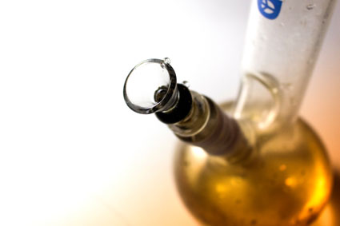
Marijuana Reasonable Suspicion
Pipes, bowls, bongs

Slide 49
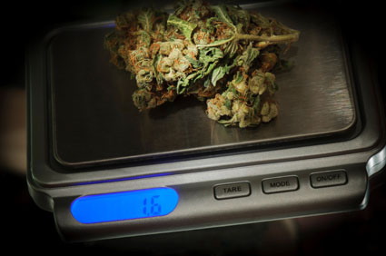
Marijuana Reasonable Suspicion
Scales

Slide 50
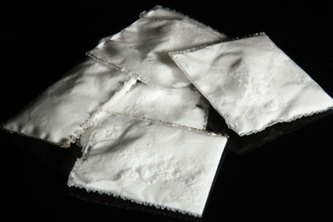
Marijuana Reasonable Suspicion
Baggies

Slide 51
Use, Possession or Sale in Workplace

Slide 52
Will You Detect Possible Use?
“How high is too high? KIRO tests pot-smoking drivers to find out.”

Slide 53
Questions?
Contact me at:
559.256.5000 or larsen@flclaw.net
Read my blog at: www.flclaw.net/blogs/california-hr
Register for our Legal Beagle Bagel Breakfasts at receptionist@flclaw.net

