Slide 1
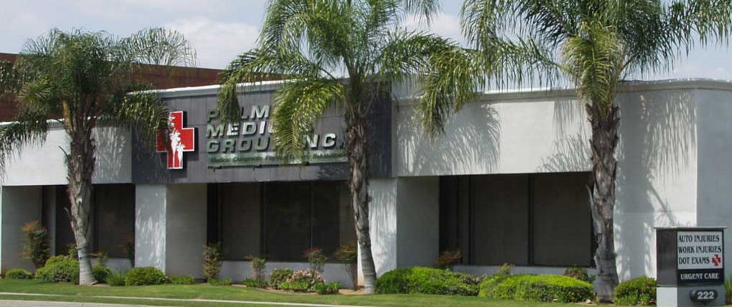
CVSS Weeding Thru the Issues 2017
The materials do not constitute an integrated text or an exhaustive analysis of the law or the subject matter. Presented for information proposes only and as a sampling of available Materials & Information.

Slide 2
I. Frank Huljev
Administrative Director, Palm Medical Group Inc.
Doctor of Chiropractic Since 1992
Qualified Medical Examiner Since 1993
Industrial Disability Evaluator, CCA 1992
Certified Functional Capacity Evaluator
National Registry of Certified Medical Examiners (NRCME)
Breath Alcohol Trainer (BAT)
NIDA Drug Collection Instructor

Slide 3

The Gold Standard
49 CFR Part 40
DOT Federal Specimen Collection Process Defined

Slide 4

DOT Program Goals (continued)
Ensure the Fairness & Integrity of the testing process – Omnibus Transportation Employee Testing Act of 1991.
  Maintain employee privacy & confidentiality.
  Have “Gatekeepers” in place to ensure “due process.”
    Certified Drug Testing Laboratories
    Medical Review Officers & Substance Abuse Professionals
    Administrative Law Judges & Arbitrators
    Federal Courts [e.g., Decision on Direct Observation]
  Systems must be auditable & reviewable by DOT Agencies.
  Develop “plain-language” regulations, policies, and guidance documents.
4
Notes:
4

Slide 5






DOT Drug & Alcohol Testing
Regulated Industry Program
5
Notes:
5

Slide 6
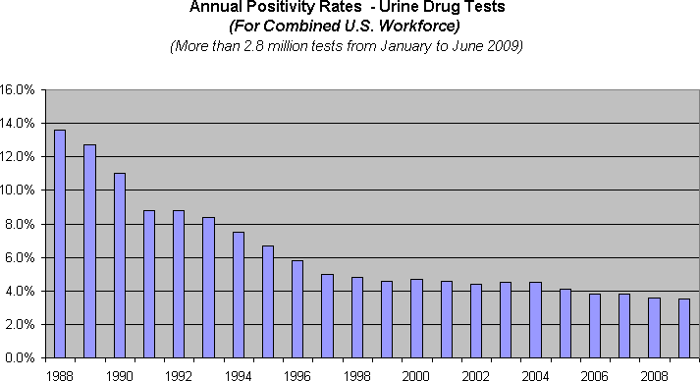
The Program Works
Sustained Drop in Overall Drug Use
~ Each Horizontal Grid Line Represents 1% ~
6
Notes:
6

Slide 7
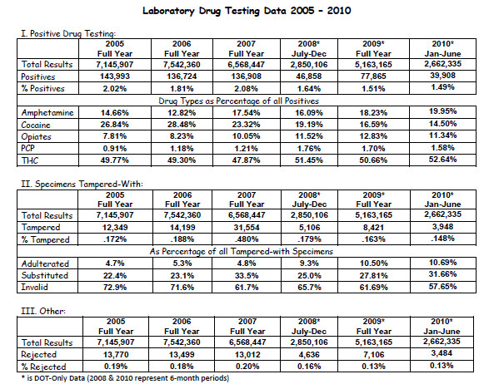
Drug Testing Data Since 2005
Notes:
Here’s what the past 6 years tells us.
Positives on the decline – good news.
Amphetamine above Cocaine [three straight reporting periods] [consistent with Quest Data]
MJ most prevalent & rising [consistent with ONDCP & other indices]
7

Slide 8
Recent Events
DOT’s “Medical Marijuana” Guidance – October 2009
Bottom Line: Medical Review Officers will not verify a drug test as negative based upon information that a physician recommended that the employee use “medical marijuana.” It remains unacceptable for any safety‐sensitive employee subject to drug testing under the Department of Transportation’s drug testing regulations to use marijuana.
Public Interest Exclusion – Published November 17, 2009

Slide 9
Types of Drug Test
Urine Drug Test
*Rapid or “instant”
*Laboratory Based (DOT and non-DOT)
Hair Collection
Blood Collection < don’t do please
Cheek Swab – instant or lab based

Slide 10
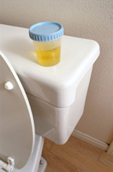
The Urine Drug Collection
§40.31-§40.73 & §40.191- §40.209

Slide 11
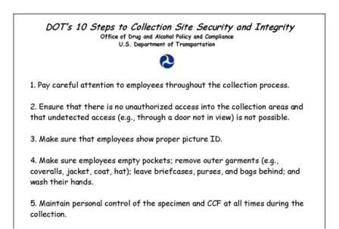
Security and Integrity

Slide 12
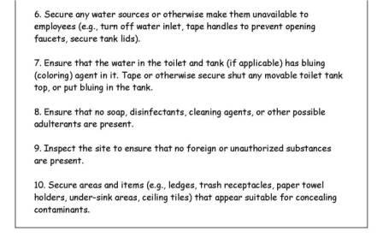
Security and Integrity

Slide 13
Collection Steps
Employee reports for test
Collector verifies identity - photo ID
Collector explains basic collection procedures to employee
  Ex. Backside of CCF (copy 5), posters displayed at site, checklists used by collector
Collector reviews CCF and completes

Slide 14
The Collection Site
Two types: single toilet restroom and multi-stall restroom
Site must have:
  Restroom or stall with toilet
  Source of water to wash hands
  Suitable clean surface for area to complete paperwork and collection steps
Collector must secure water sources and other possible adulterants

Slide 15
Instructions to employee
Collector must inspect the restroom before (& after) every specimen collection
The collector gives a collection kit to the employee or the employee is allowed to select a kit
Collection kit is opened in the presence of both collector and employee
Collector directs the employee to go into restroom, provide a specimen of at least 45 mL, do not flush the toilet and return the specimen to the collector as soon as possible

Slide 16

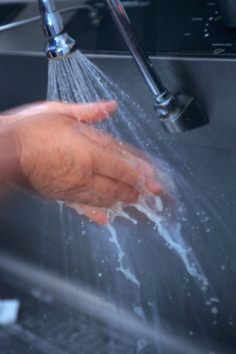
Pre-collection steps
Collector directs the employee to remove unnecessary outer garments
Collector directs the employee to empty pockets and display items
Collector directs the employee to wash and dry their hands

Slide 17
Post collection steps
Collector accepts specimen from employee
Collector must check the following:
  Temperature of specimen – within 4 minutes
  Specimen volume – 45 mL
  Signs of adulteration/substitution
Collector completes Step 2 of CCF

Slide 18
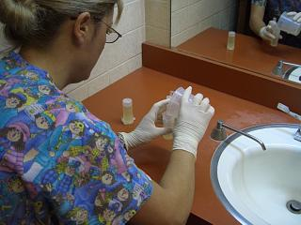
Accepting/securing specimen
Collector will open specimen bottles
Collector will pour 30 mL into one specimen bottle (primary/A) then at least 15 mL into other specimen bottle (split/B)

Slide 19
Routine Collections
Specimen preparation
Complete Step 2 of CCF
The collector pours the urine into the transport bottles
  Seal “A” on the primary bottle with at least 30 ml of urine
  Seal “B” on the bottle with at least 15 ml of urine
Complete Step 3 of CCF
  Collector attaches labels
  Collector dates labels
  Donor initials labels

Slide 20
Federal Custody & Control Form
The CCF must be a five-part carbonless manifold form:
    Copy 1 – Laboratory
    Copy 2 – Medical Review Officer (MRO)
    Copy 3 – Collector
    Copy 4 – Employer (DER)
    Copy 5 – Donor
    ➔ DISTRIBUTE APPROPRIATELY

Slide 21
SHY BLADDER continued…
  Start water log/notations in “Remarks”
  3 hours and 40 ounces
  A responsible party must observe the employee during the 3 hours

Slide 22
INSUFFICIENT SPECIMEN
  Dump the initial specimen
  New collection kit
  Original CCF
  Record time in “Remarks”
  Start water log/notations in “Remarks”
  3 hours – 40 ounces

Slide 23
Failed Test if….
Leaving Site before giving sample
Refusing to follow Collector Instruction
Foul Language or Abusive Behavior
Threats to Staff
Cold Urine (not 90- 100 degrees)
*Cold Urine DOT collected and 2nd Observed
2nd Collected > both samples sent to lab.

Slide 24
Refusal to Test
Considered by DOT = Failed test
Considered by PALM = Failed test
Employers = ??? You decide
(unless ER is DOT employer)

Slide 25
The Collector
Part 40 defines a collector as a trained person who instructs and assists employees at a collection site, who receives and makes an initial inspection of the urine specimen provided by those employees, and who initiates and completes the Federal Drug Testing Custody and Control Form (CCF).

Slide 26
Direct Observation Collections
Collections under direct observation are required when:
  Temperature out of range
  Specimen shows signs of tampering
  Collector finds item intended for adulterating or substituting specimen
  Directed by MRO
  Test reasons are Return to duty and Follow-ups
Specific protocol – lift, lower, turn around

Slide 27
Direct Observation Cont.
D.O. collection must occur immediately
Same-gender observer
  Need not be a trained collector
Observer must:
  Require that donor disrobe (to chest, knees) and rotate to display absence of devices
  Watch urine travel from body to cup
  Record name on CCF (if not collector)

Slide 28
Refusal to test continued
For a direct observed collection, failure to follow collector’s instructions
Possessing or wearing a prosthetic or other device that could be used to interfere with testing process
Admission to collector (or MRO) that employee adulterated or substituted specimen

Slide 29
Beating the drug test
Three common methods:
  Dilution – adding water (less common) or drinking large quantities of fluids (more common)
  Adding adulterant to specimen – designed to breakdown drug metabolites or interfere with laboratory instruments
  Substituting a “clean” specimen

Slide 30
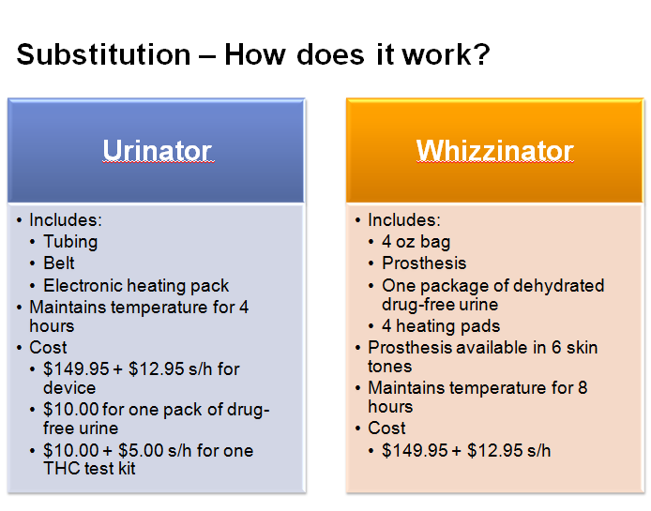

Slide 31
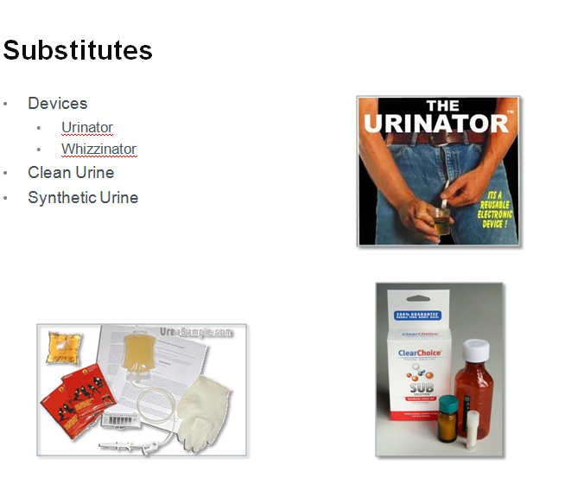

Slide 32
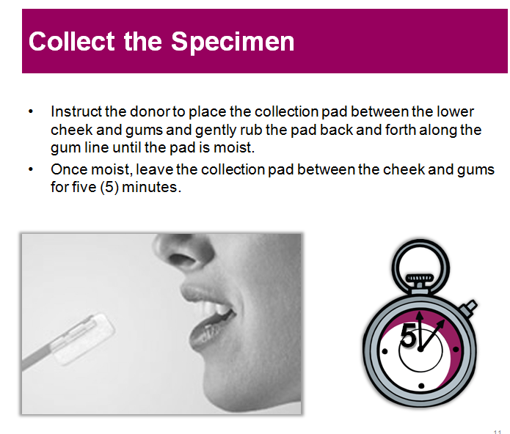

Slide 33
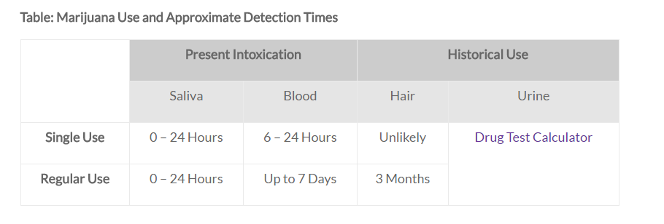

Slide 34
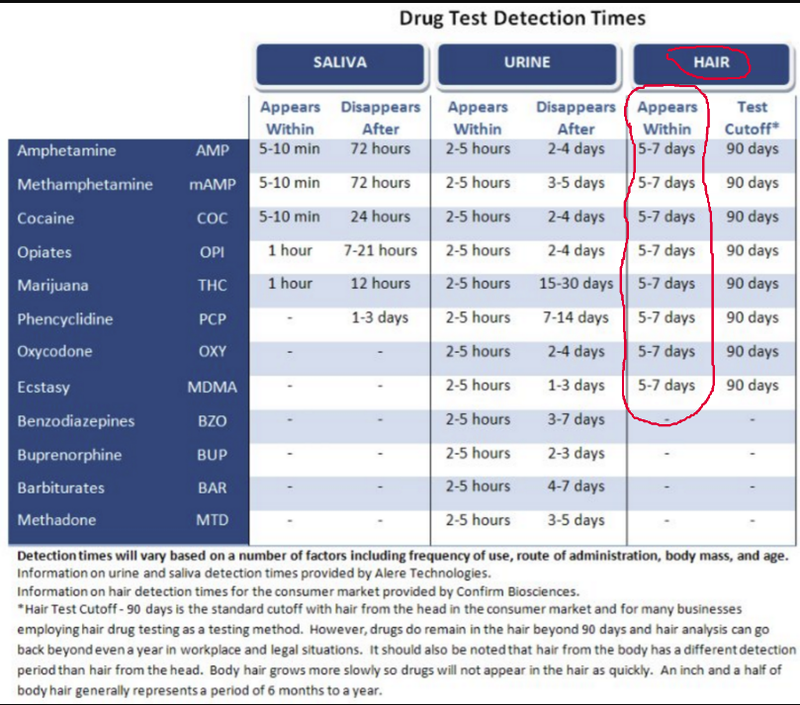

Slide 35
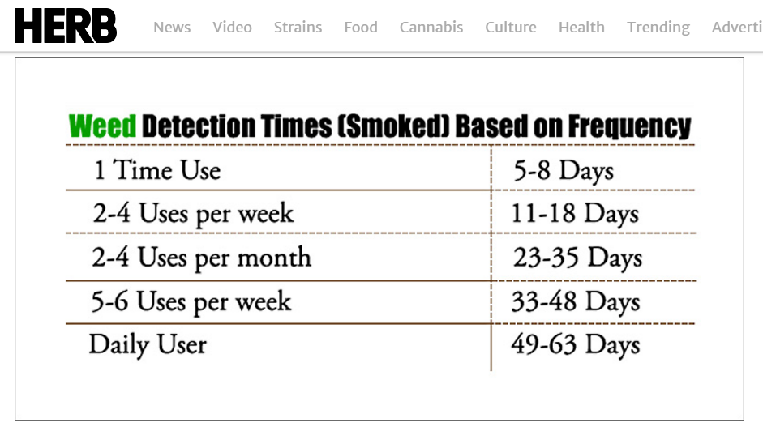

Slide 36
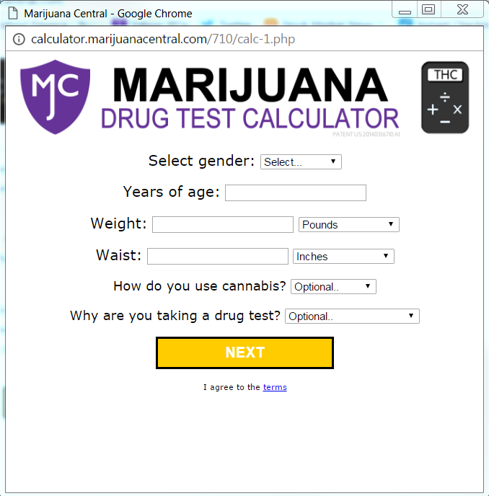

Slide 37
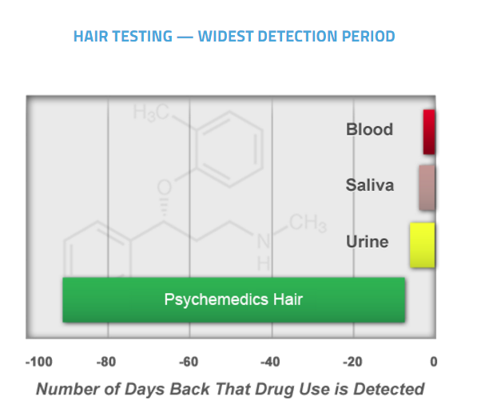

Slide 38


Slide 39
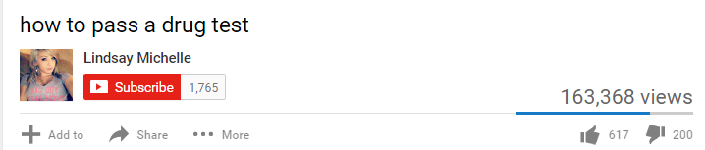

Slide 40
